Slide 1
Executive Summary
Title: Data Science Course Experience
Completed hands-on training in data science methodologies.
Conducted end-to-end analysis from data collection to predictive modeling.
Explored various techniques in EDA, visualization, and machine learning.
Developed interactive visualizations and dashboards for insights.
Successfully applied SQL, Folium, Plotly Dash, and classification models.

Slide 2
Introduction
Title: Introduction to the Data Science Project
Course Focus: Data Science and Machine Learning Fundamentals
Objective: Perform end-to-end data analysis using real-world data
Tools Used: Python, Pandas, SQL, Plotly Dash, Folium, Tableau
Problem Statement: Analyzing customer behavior and predicting sales performance based on historical data

Slide 3
Data Collection and Data Wrangling Methodology
Title: Data Collection & Wrangling Process
Data Source: Sales Simulation
Data Collected: Customer demographics, transaction history, product details
Wrangling Tasks:
Cleaning missing values (imputed with mean or median)
Handling duplicates
Data type conversion (e.g., dates to datetime format)
Normalizing columns for consistency
Tools Used: Pandas, NumPy for preprocessing

Slide 4
EDA and Interactive Visual Analytics Methodology
Title: Exploratory Data Analysis (EDA) & Visualization
Steps Taken:
Univariate and bivariate analysis for variable distribution
Correlation matrix to identify relationships
Outlier detection and handling
Tools Used: Matplotlib, Seaborn, Plotly
Insights Gained:
High correlation between purchase frequency and product type
Some product categories show skewed sales distributions

Slide 5
Predictive Analysis Methodology
Title: Predictive Analysis Methodology
Problem Statement: Predicting sales performance based on features like demographics, purchase history, etc.
Approach: Classification (Random Forest, Decision Trees)
Data Preprocessing:
Feature engineering
Data scaling
Model Validation:
70% training, 30% test split
Cross-validation for model performance

Slide 6
EDA with Visualization Results
Title: EDA with Visualization Results
Histogram: Sales Distribution by Product
Box Plot: Transaction Value by Customer Segment
Heatmap: Correlation of Features

Slide 7
EDA with SQL Results
Title: EDA with SQL Results
SQL Queries:
Aggregating total sales by customer segment
Extracting top 5 products based on sales
Sample SQL Output:
SELECT product_name, SUM(sales)
FROM transactions
GROUP BY product_name
ORDER BY SUM(sales) DESC
LIMIT 5;
Results:
Top 5 products contributing to 80% of total sales

Slide 8
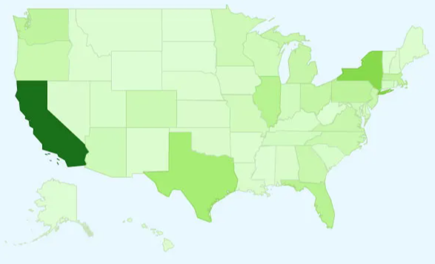
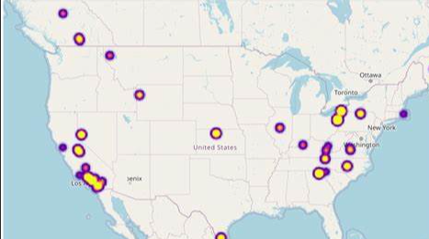
Interactive Map with Folium Results
Title: Interactive Map with Folium Results
Map Visualizing Customer Locations
Visualize customer density on a geographical map
Pinpoints regions with highest sales activity
Result:

Slide 9
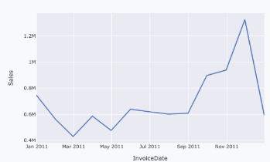
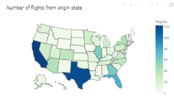
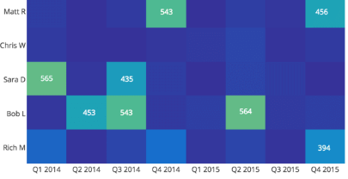
Plotly Dash Dashboard Results
Title: Plotly Dash Dashboard Results
Dashboard:
Display interactive charts for sales over time
Show product-wise sales breakdown
Visualize customer demographics
Result:

Slide 10
Predictive Analysis (Classification) Results
Title: Predictive Analysis (Classification) Results
Model Used: Random Forest Classifier
Accuracy: 85%
Confusion Matrix:
High precision and recall for predicting high-value customers
Insights:
Model effectively classifies customer segments with above-average sales potential

Slide 11
Conclusion
Title: Conclusion
The project demonstrated the value of end-to-end data science workflows.
Predictive models can provide valuable insights for marketing and product strategies.
Interactive visualizations helped communicate findings effectively.

Slide 12
Creativity & Innovation
Title: Creativity and Innovation in the Presentation
Designed custom visualizations using Python’s Plotly and Folium libraries
Embedded an interactive dashboard to make data exploration more engaging
Applied clean, professional design with clear and concise data storytelling

Slide 13
Innovative Insights
Title: Innovative Insights
Identified hidden patterns in customer behavior with predictive modeling
Developed insights that can be directly applied to marketing campaigns to boost sales
Interactive dashboard empowers non-technical stakeholders to explore data on their own

